Slide 1
TensorFlow Features in Images, Part 3
COMP 4230

Slide 2
ALERTS
Lab 2 due Friday
During Fall Break, Read Chapter 4 of Moroney and Chapter 10 of Larson
We will not spend class time on chapter 4, so read it carefully, play with the code samples and try using different features of TFDS
We will begin Chapter 5 of Moroney after break

Slide 3
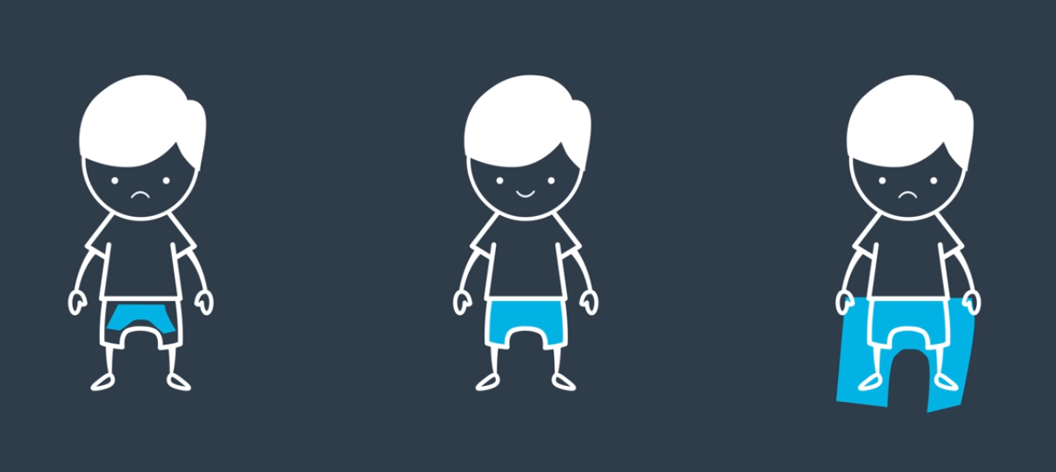
(Over)fitting
When we say that we are fitting a model to the data, what does that mean?
Literally, we are attempting to discover a mathematical function that maps the input data to the correct output
Even if this function is multi-variable and non-linear
What does this mean?

Slide 4
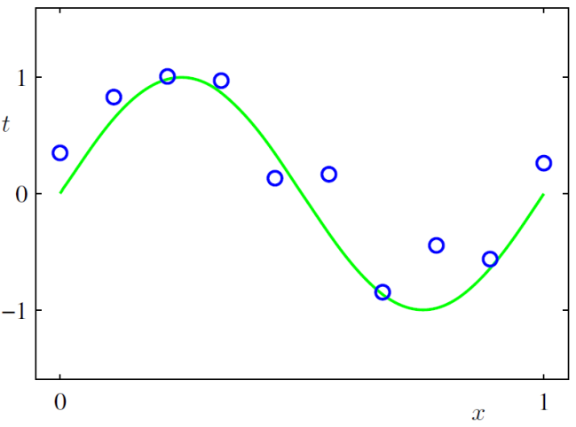
(Over)fitting $f\left(x\right)=sin\left(2πx\right)+ε$
Machine Learning and Pattern Recognition, Christopher M. Bishop

Slide 5
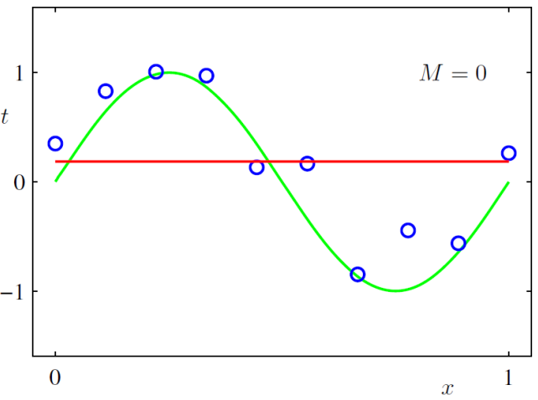
(Over)fitting $f\left(x\right)=sin\left(2πx\right)+ε$
If we choose a constant model it severely underfits the data
M = the degree of the polynomial model
Machine Learning and Pattern Recognition, Christopher M. Bishop

Slide 6
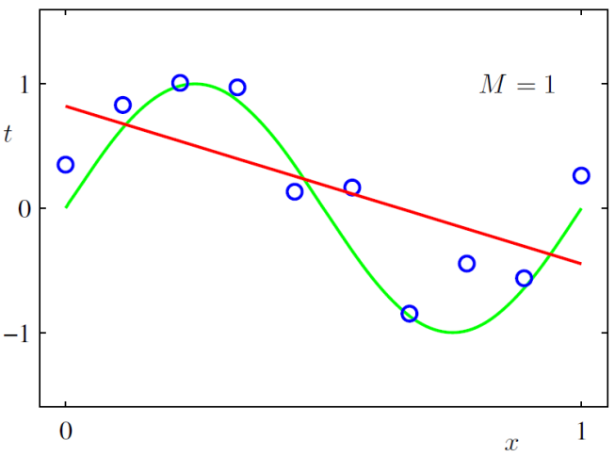
(Over)fitting $f\left(x\right)=sin\left(2πx\right)+ε$
If we choose a linear model it still underfits the data
Machine Learning and Pattern Recognition, Christopher M. Bishop

Slide 7
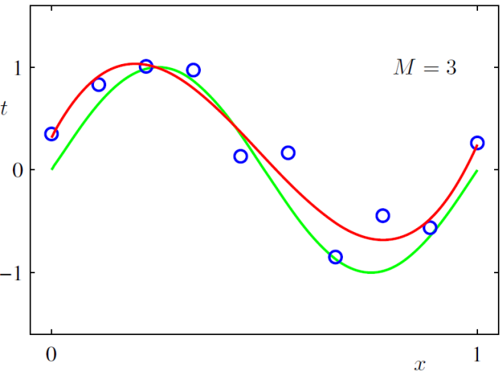
(Over)fitting $f\left(x\right)=sin\left(2πx\right)+ε$
A cubic model, however, does a fairly nice job
Machine Learning and Pattern Recognition, Christopher M. Bishop

Slide 8
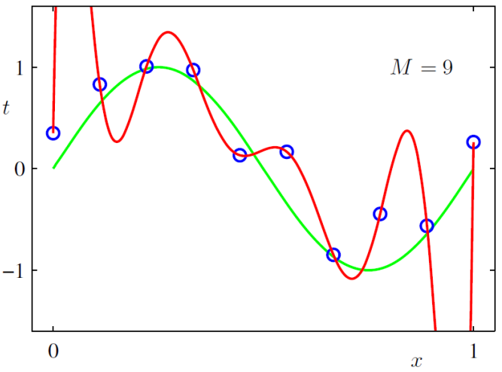
(Over)fitting $f\left(x\right)=sin\left(2πx\right)+ε$
When you provide too many degrees of freedom, it gets carried away ☺
Machine Learning and Pattern Recognition, Christopher M. Bishop

Slide 9
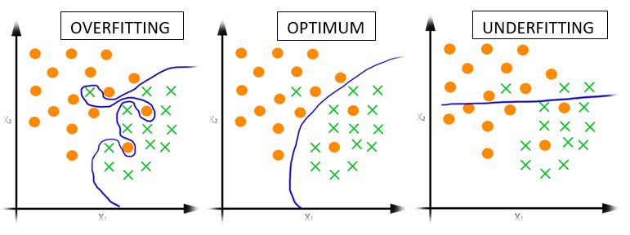
(Over)fitting
This concept applies equally well to categorical modeling.
Here we are trying to choose a function that separates the orange dots from the green x's.

Slide 10
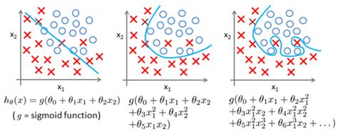
(Over)fitting
We are using function here not as in y = f(x), where the y-coordinate is a function of the x-coordinate. If that were the case what you see below aren't legitimate functions (vertical line test?). Rather, we mean a multi-variable function in which both axes are parameters to the function.

Slide 11
(Over)fitting
In a neural network, there are thousands or millions of parameters being learned, which means that we are operating not in a 2D space but a 1000D or 1MD space
This is impossible to visualize!
As an illustration, what would it be like in 3D?
The function used to separate values would have to be a surface, not a curve
In other words to separate an n-dimensional space you need an (n-1)-dimensional object

Slide 12
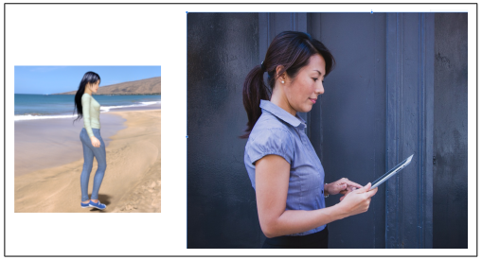
Tensorflow Overfitting Images
What did you see happening in lab 2?
What can we do about it?
Reduce the degrees of freedom (number of hidden layers/nodes)
Increase the variability of the training set to be more representative
Image Augmentation

Slide 13
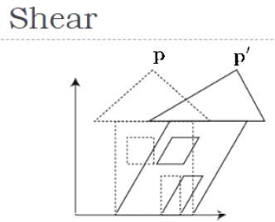
Image Augmentation
Rotations
Horizontal shifting
Vertical shifting
Shearing
Zooming
Flipping
train_datagen = ImageDataGenerator(
rescale = 1./255,
rotatation_range = 40,
width_shift_range = 0.2,
height_shift_range = 0.2,
shear_range = 0.2,
zoom_range = 0.2,
horizontal_flip = True,
fill_mode = 'nearest'
)

Slide 14
Image Augmentation
If you enable image augmentation, the training will take longer since it is performing image processing
And the training accuracy may not be as good after the same number of epochs (you may have to train longer)
But you should find that the validation accuracy is much better. In other words, you've reduced the overfitting tendency.

Slide 15
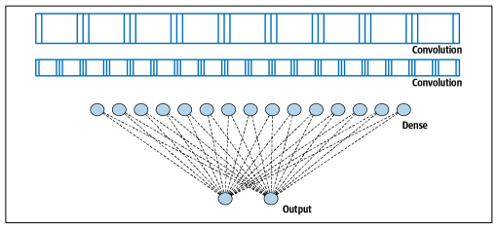
Transfer Learning
The CNNs that we've built so far can be visualized like this:

Slide 16
Transfer Learning
But rather than learning the convolutions from scratch, we can leverage models that have previously been trained (perhaps with richer data sets and more robust computational resources)
If we import the convolutional layers from a previously trained network, and lock them so that they no longer are trainable, they become portable compiled modules for reuse.

Slide 17
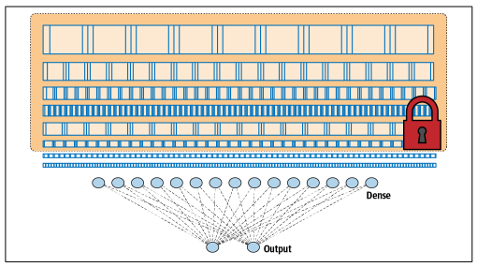
Transfer Learning
The CNNs that we get then would look like this:

